Slide 1

Human Trafficking: Country Matters!
Submission for: Hackathon for Hope 2019
Team Members: Jon Strunk, Ursula Saelzler, Heather Capell

Slide 2
Questions We Explored
What are some drivers of Human Trafficking?
What is the movement of Human Trafficking victims between countries?
What is the breakdown of type of Human Trafficking by country?
What is the breakdown of means of control by country?
How can we use this information to maximize the effectiveness of Human Trafficking prevention and awareness campaigns?

Slide 3
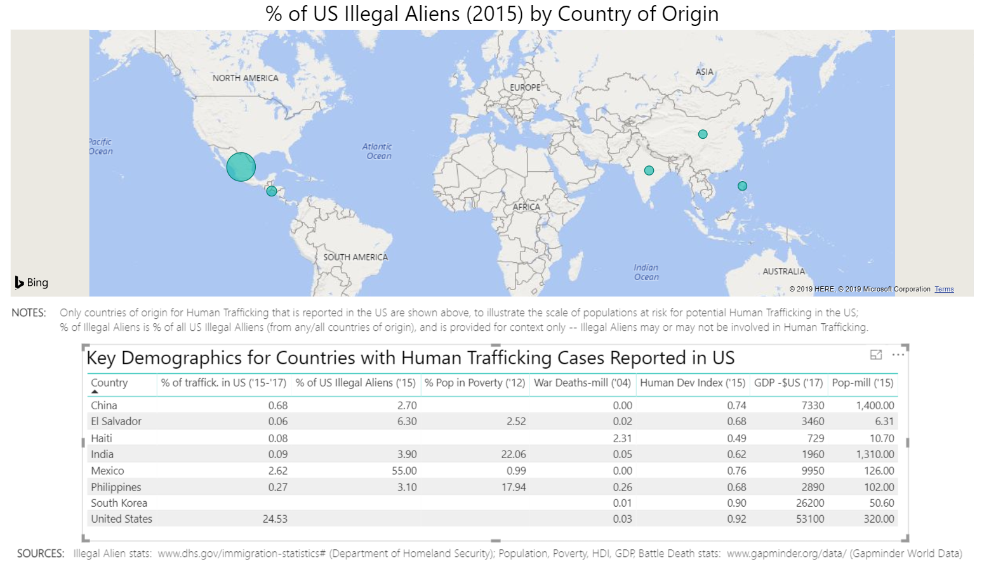

Slide 4
Categorization of Trafficking Movements
Countries where victims remained
Countries where victims were imported
Countries where victims were exported
Notes:
Given that human trafficking is a world wide issue, we can take a birds eye view of process and investigate who are the consumers and who are the producers of human trafficking victims, and who are keeping their full operation in house.
The Hack-a-thon dataset contains a wealth of information about citizenship, country of exploitation, and the type of exploitation reported. As not all countries reported every year of the dataset we restricted this analysis to 2015 and above. We also made the assumption that for countries were citizenship was listed but country of exploitation was not, the were the same. This assumption mainly affected the reported cases of the Philippines.
In-order understand the movements of human trafficking victims we were able to split the countries into movement groups.
1. Exploitation countries where over half the victims claimed citizenship of the exploitation country
2. Exploitation counties where over half the victims did not claim citizenship from the exploited countries
3. Citizenship countries where over half the victims were found in other countries
In the following 3 geographic maps, the size of the country marker reflects the total number of remained, imported, or exported

Slide 5
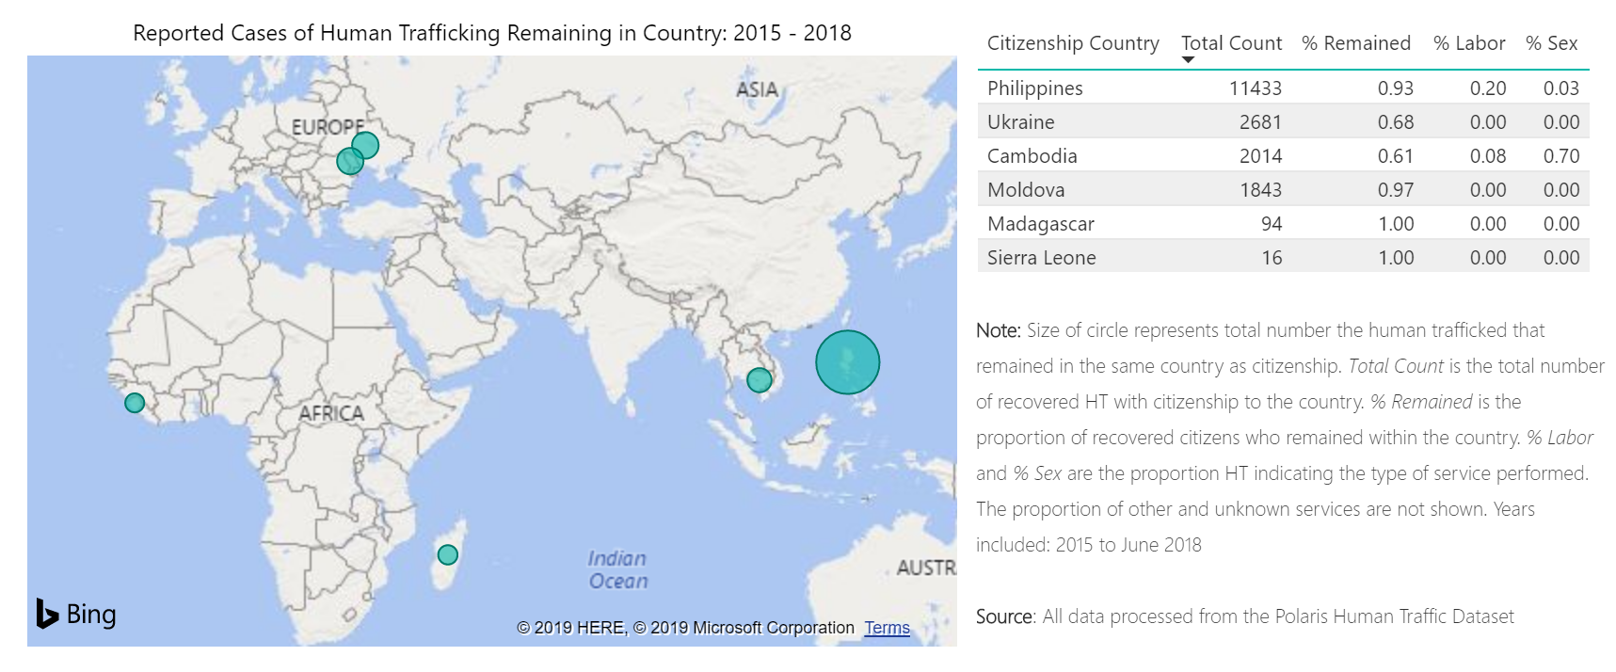
Notes:
We found 6 countries were the reported victims were largely kept within their country, with the largest population found in the Philippines.
With the exception of Cambodia, we do not have a lot of information about the type of work the victims were engaged in.

Slide 6
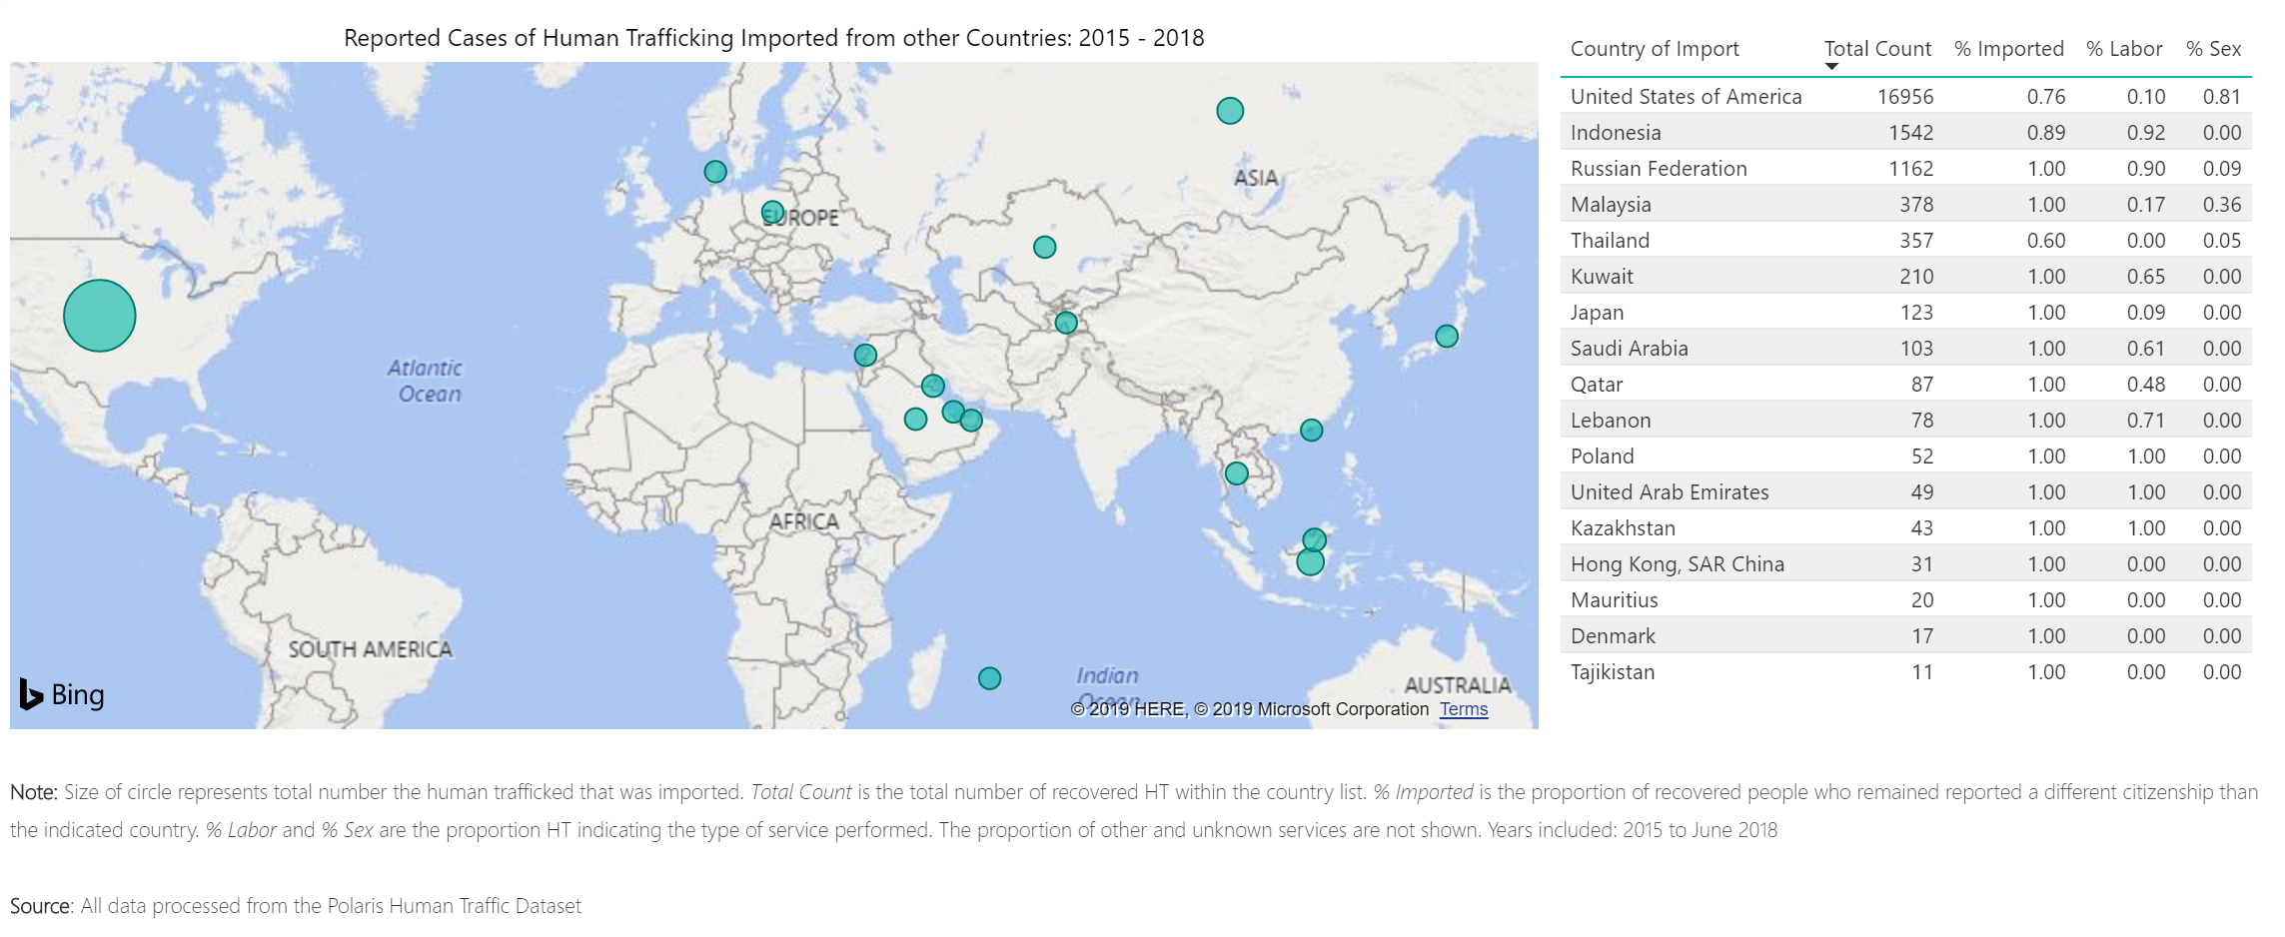
Notes:
We found 17 countries who’s recovered victims reported a different country of origin than the one they were found in.
Interestingly, the USA led with the largest amount of imported victims as well as the highest percentage of those involved in the sex trade.
While other countries tended to engage in the forced labor trade to a greater extent.

Slide 7
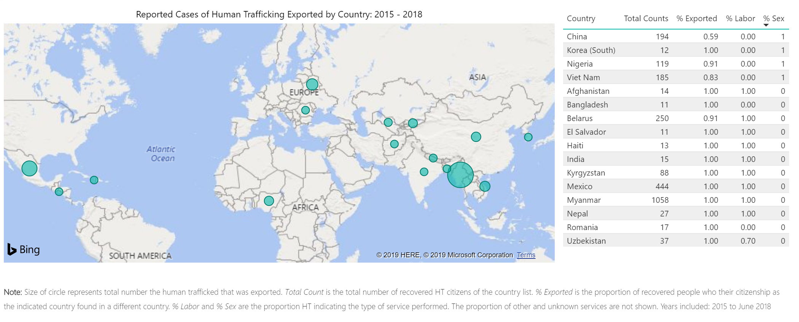
Notes:
Finally 16 counties were found in which the majority of victims claiming citizenship were found in other countries. Interestingly, these countries of export appear to focus their trafficking efforts on either forced labor or sex.
This data suggest that Trafficker’s are specialized into either Sex or of Labor exploitation.
Next, Ursula will discuss how victims are controlled and how this is reflected by the country of origin and type of trafficking

Slide 8
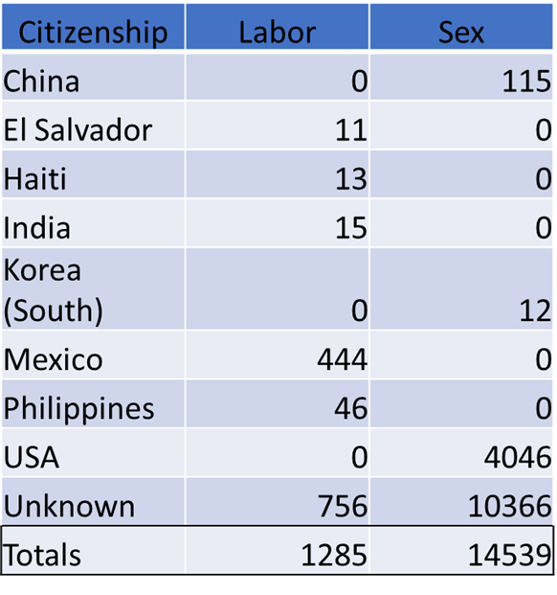
Notes:
As Jon mentioned, the United States imported the highest number of human trafficking victims later identified in the hackathon data.
While this dominance may accurately reflect human trafficking rates in the United States compared to the rest of the world,
it is likely biased by the large number of victims identified by the US-based Polaris hotline that are included in the hackathon data.
Despite the difficult of interpreting these numbers in the context of global human trafficking rates, we believe that the examination of patterns based on country
of origin for those human trafficking victims identified in the United States may provide insight into how these individuals are being trafficked,
as well as the best practices for reaching and educating these individuals.
We first wanted to examine whether there were differences in the type of exploitation victims typically experienced based on country of origin.
As seen in the table, the type of exploitation experienced by a victim of human trafficking was extremely polarized by country of origin, such that every
country of origin representing only one type of exploitation.
We wanted to further examine these trends to determine if there were country of origin specific trends in the methods used to control victims of human trafficking.

Slide 9
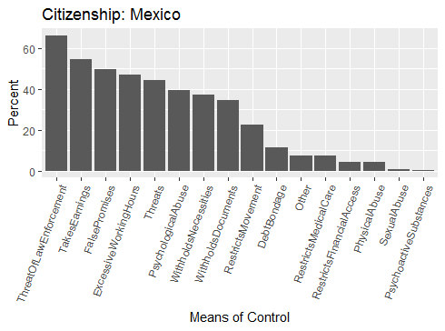

Notes:
We first examined the means of control used for those individuals involved in labor exploitation originating from Mexico.
The values in the charts represent the total percentage of respondents that reorted a listed means of control.
Although for all countries examined a number of respondents did not specify a means of control,
this category was treated as missing data, and is not included in the charts.
Of the 444 individuals identified by the hotline the most commonly reported means of control,
affecting 295 individuals, approximately two-thirds of all cases,
was the threat of law enforcement.
While an additional 153 individuals reported that their traffickers withheld documents as a means of control.
Although speculative,
this data combined with the reported high rate of illegal immigration to the United States from Mexico,
suggests that these individuals are particularly susceptible to means of control related to illegal immigration status.

Slide 10
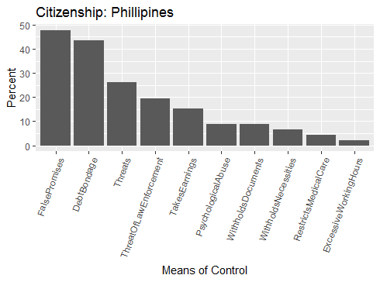
Notes:
Conversely, of the 46 individuals of Fillipino citizenship,
a group that also reported being exclusively involved in forced labor (rather than sexual exploit),
only 9 reported experiencing the threat of law enforcement, and 4 reported document withholding by their traffickers.
Instead, False Promises and Debt Bondage were the primary reported means of control for this group.

Slide 11
Notes:
A similar examination of the means of control used for individuals originating from the United States and China,
the two largest contributors to sexual exploitation in the United States,
similarly suggests that country of origin may be informative about how individuals are victimized.

Slide 12
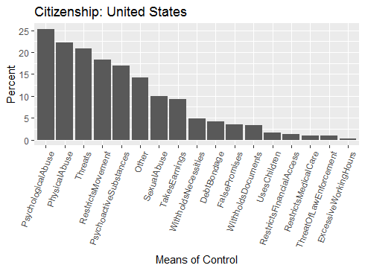
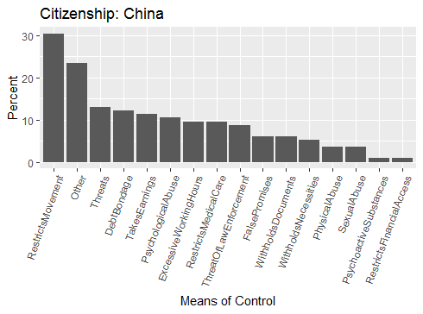
Notes:
While both groups are frequently controlled by restriction of movement and threats,
those originating from the United States are largely controlled by abuse, both psychological and physical, and psychoactive substances.

Slide 13
Notes:
Chinese immigrants were likely to report debt bondage as means of control used by their traffickers,
while this was less frequent amongst American citizens.
We believe that this distinction in the means of control used may be important to understand in order to create targeted campaigns.
That is,
while educating individuals about appropriate wages and work compensation may be beneficial for Fillipino immigrants who are often controlled through false promises,
this information is less likely to benefit Mexican immigrants who are predominantly controlled by threats of law enforcement,
despite both groups representing labor exploits.
Similarly, it may be most effective to publish materials concerning the illegal practice of debt bondage in Chinese than in English,
given that the practice is rarely used when American citizens are exploited.

Slide 14
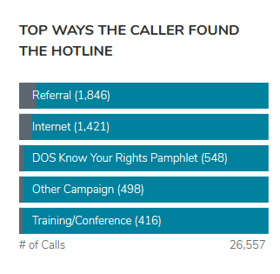
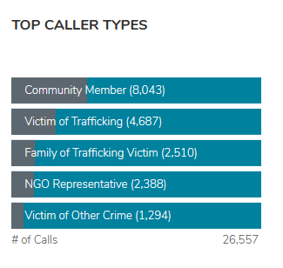
https://humantraffickinghotline.org/states
Notes:
The need for targeted materials reaching the victims of trafficking is illustrated by statistics published on the Polaris website.
In 2017, over 8,000 calls to the hotline were made by community members,
while 4,600 calls were made by victims of trafficking, this suggests that many victims of trafficking are not aware of the hotline.
This lack of awareness is further evidenced by the high rate of 'referral' [from another organization] as the reported way the caller discovered the hotline.
This suggests that concerned community members and victims of trafficking alike may not be aware of potential resources.

Slide 15
Guidance for Prevention Campaigns
Human trafficking follows migration patterns closely
ACTION: continue to monitor areas of high migration, and target educational / preventive campaign at immigrant populations
Countries tend to fall into one of three groups (trafficking exporter, importer, or remaining in-country), and often with a primary form of trafficking (labor vs. sex trafficking)
ACTION: preventive campaigns must focus on different topics (labor vs sex) and activities (importer vs exporter) depending on country
Primary means of control differs, depending on country
ACTION: preventive campaigns must address different means of control depending on country
Notes:
Our exploration of the hackathon data,
as well as other published materials on the topic suggest that human trafficking patterns are heavily impacted by migration patterns.
Therefore, migration patterns can be used to help predict human trafficking patterns,
as well as to inform organizations on how to prepare effective anti-trafficking campaigns by appropriately targeting
those groups accounting for a large proportion of immigration.
Further, an awareness of the source of human trafficking victims in a country,
whether they are largely imported, exported or from within the country,
can help inform the best campaign approaches.
For example, educating incoming immigrants on legal wages and working hours may be beneficial in a country where import rates are high such as the United States,
while campaigns targeting the prevention of recruitment may be more effective in countries with high export rates, such as Myanmarr.
Finally, an understanding of the methods used to control victims once they are in a country may be beneficial for creating targeted educational campaigns
and promote legal policies to encourage human trafficking victims to come forward.
Thank you for your attention and we hope that you have enjoyed our presentation Human Trafficking: Country Matters.

